Slide 1
Image Compression

Slide 2
DATA COMPRESSION
Data compression is an art or science of representing information in a compact form.
We create these compact representations by identifying & using structures that exist in the data.
Data can be characters in a text file, numbers that are samples of speech or image waveforms or sequences of numbers that are generated by other processes.

Slide 3
WHAT IS DATA COMPRESSION
A data compression program is used to convert data from an easy-to-use format to one optimized for compactness.
Compression Purposes:
Save storage space
Reduce communication capacity requirement

Slide 4
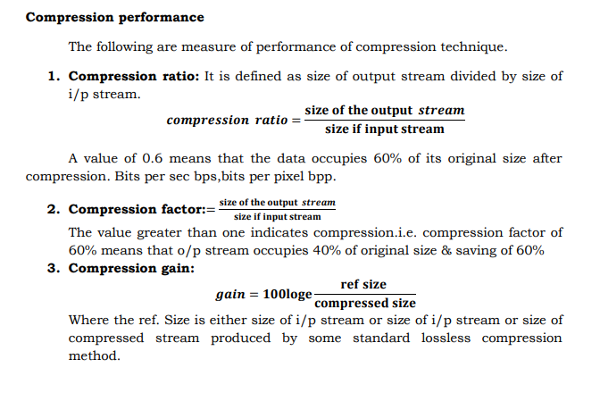

Slide 5
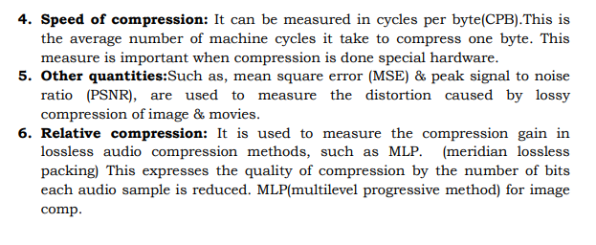

Slide 6
DATA COMPRESSION STRATEGIES
Data Compression Strategies
Lossless Compression
Lossy Compression

Slide 7
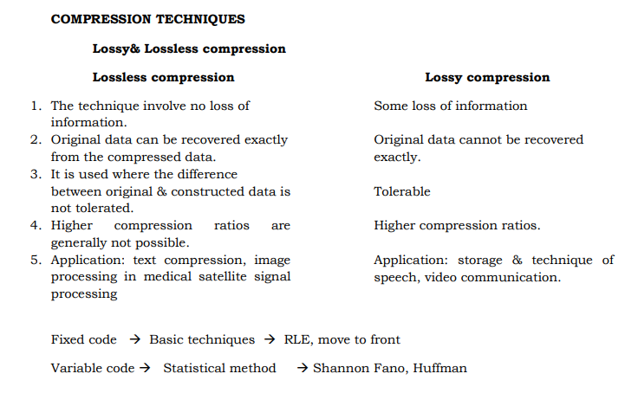

Slide 8
Lossless Compression
A lossless technique means that the restored data file is identical to the original.
This is absolutely necessary for many types of data, for example: executable code, word processing files, tabulated numbers, etc.
Different techniques for lossless compression are:
Run-length Encoder Technique
Huffman Encoding
Delta Encoding

Slide 9
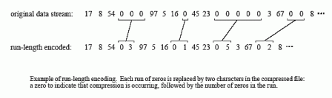
Run-length Encoder Technique
Run-length encoding is a simple method of compressing data files which frequently contain the same character repeated many times in a row.

Slide 10
Disadvantage
If the average run-length is longer than two, compression will take place.
Otherwise the encoding data length is become quite more than of original text.

Slide 11
Huffman Encoding
This method is named after D.A. Huffman, who developed the procedure in the 1950s.
More than 96% of this file consists of only 31 characters: the lower case letters, the space, the comma, the period, and the carriage return.
We will assign each of these 31 common characters a five bit binary code: 00000 = "a", 00001 = "b", 00010 = "c", etc. This allows 96% of the file to be reduced in size by 5/8.

Slide 12
Contd……
The five bit codes, 11111, will be a flag indicating that the character being transmitted is not one of the 31 common characters.
The next eight bits in the file indicate what the character is, according to the standard ASCII assignment. This results in 4% of the characters in the input file requiring 5+8=13 bits.
The idea is to assign frequently used characters fewer bits and seldom used characters more bits.

Slide 13
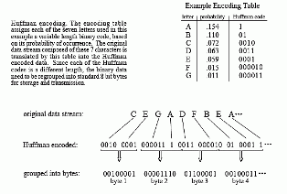
Example of Huffman Encoding

Slide 14
Implementation
To implement Huffman or arithmetic encoding, the compression and un-compression algorithms must agree on the binary codes used to represent each character (or groups of characters). This can be handled in one of two ways.
Use a predefined encoding table
Use encoding optimized for the particular data being used.

Slide 15
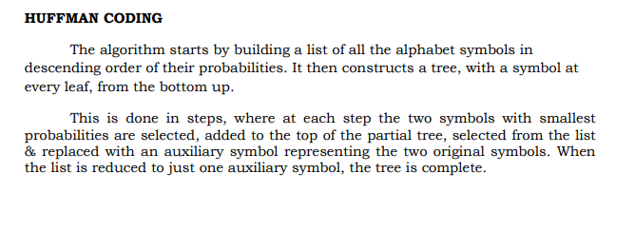
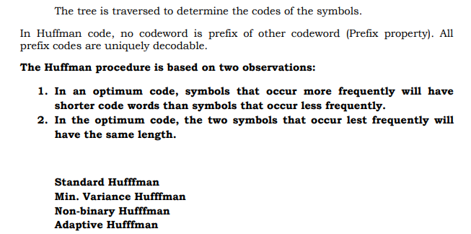

Slide 16
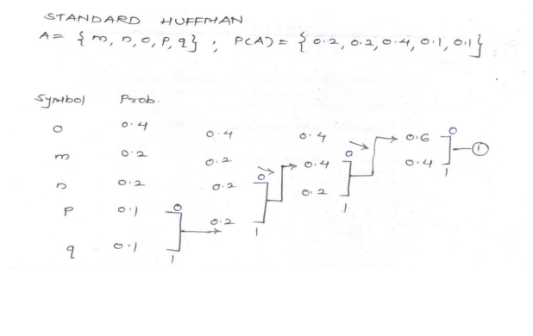

Slide 17
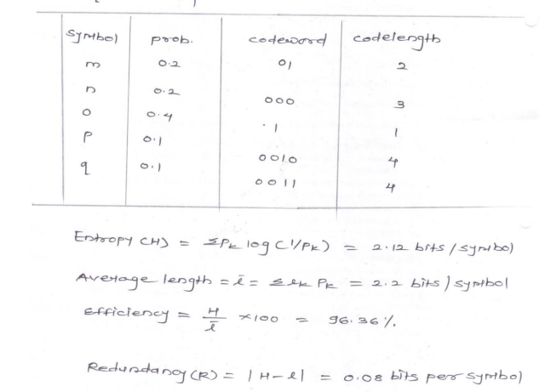

Slide 18
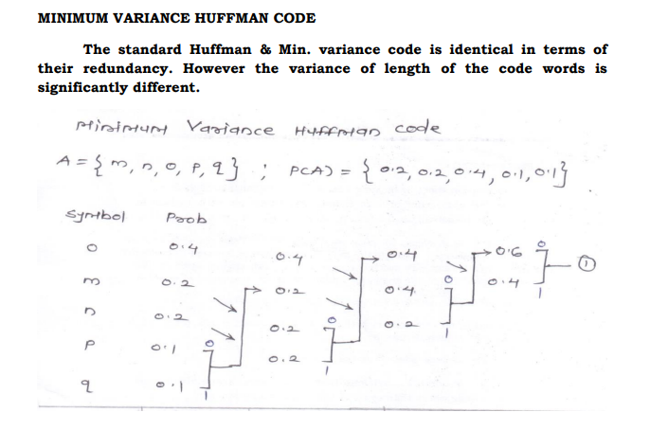

Slide 19
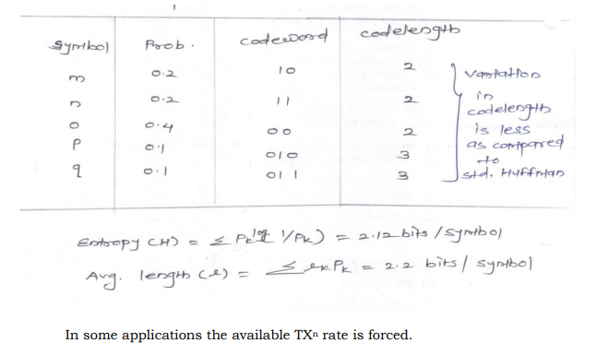

Slide 20
In Min variance Huffman code, variation in codelength is less as compared to standard Huffman code.

Slide 21
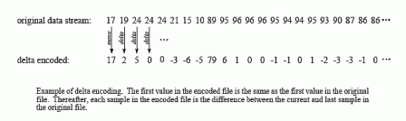
Delta Encoding
Delta encoding can be used for data compression when the values in the original data are smooth, that is, there is typically only a small change between adjacent values.

Slide 22
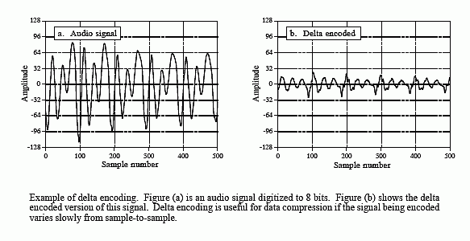
Example
It is very common when the file represents a signal.

Slide 23
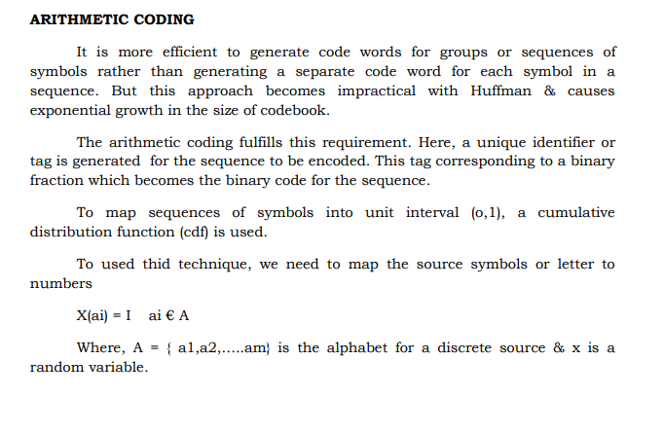

Slide 24
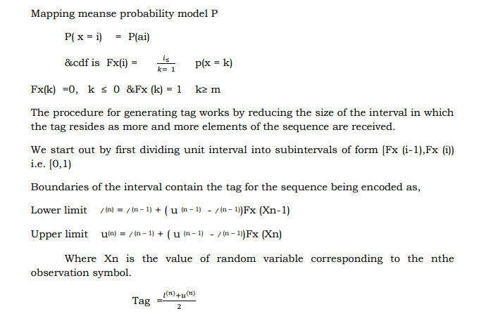

Slide 25
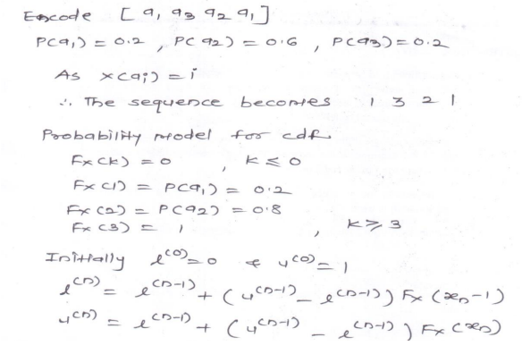

Slide 26
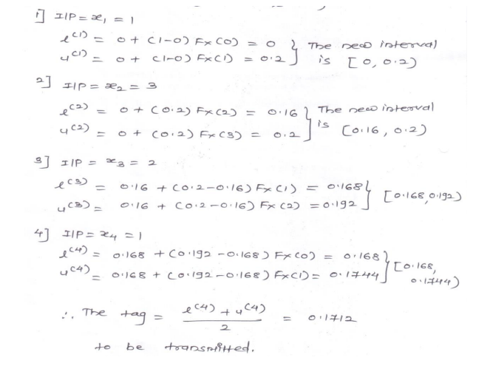

Slide 27
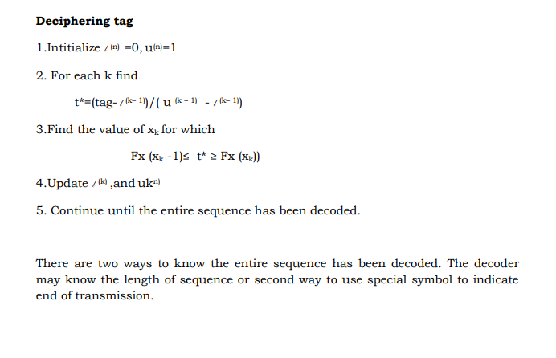

Slide 28
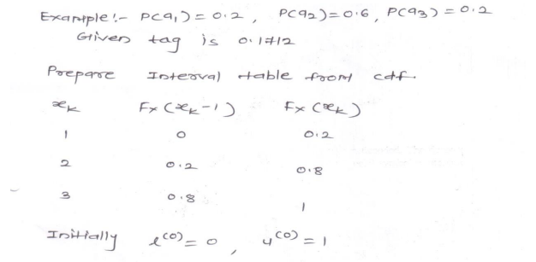

Slide 29
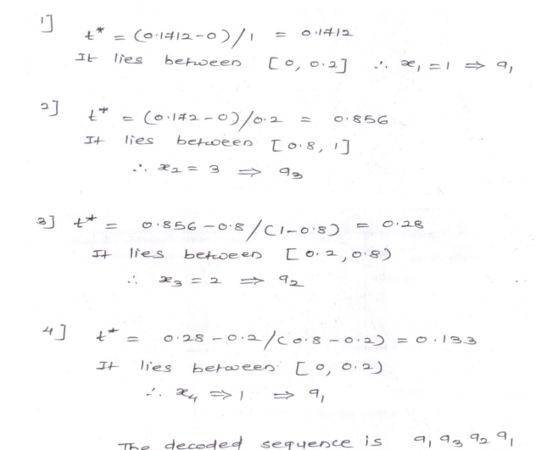

Slide 30
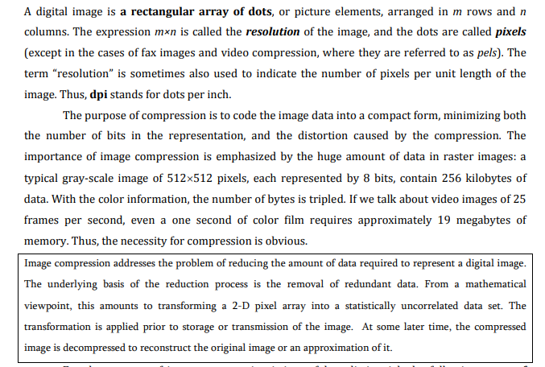

Slide 31
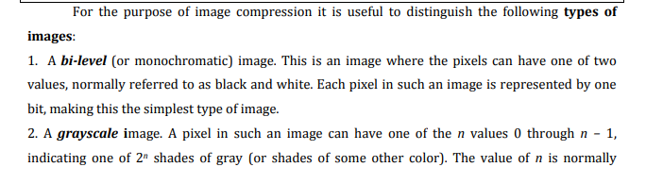
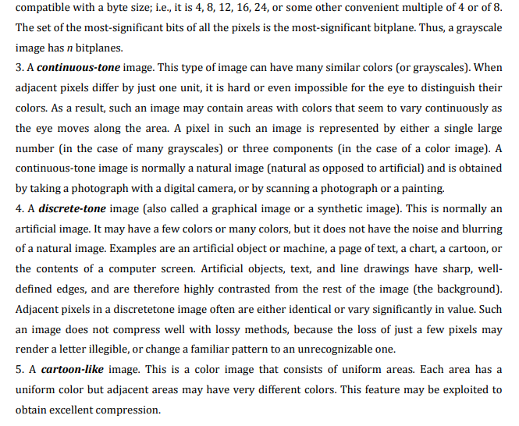

Slide 32
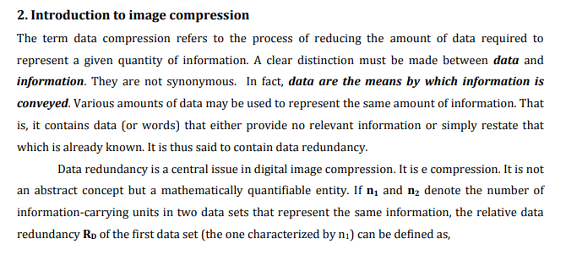

Slide 33
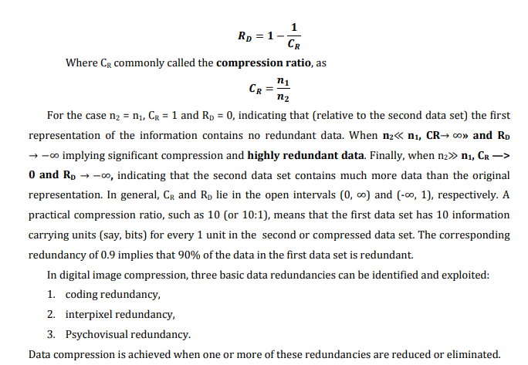

Slide 34
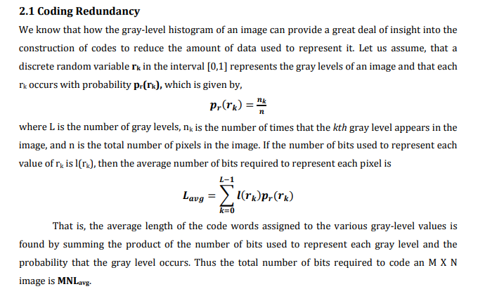

Slide 35
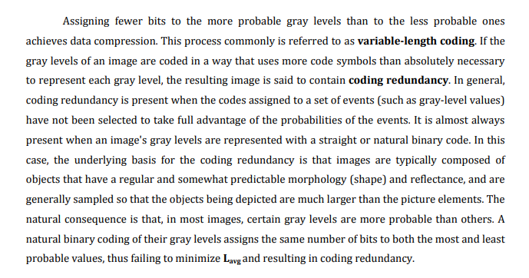

Slide 36
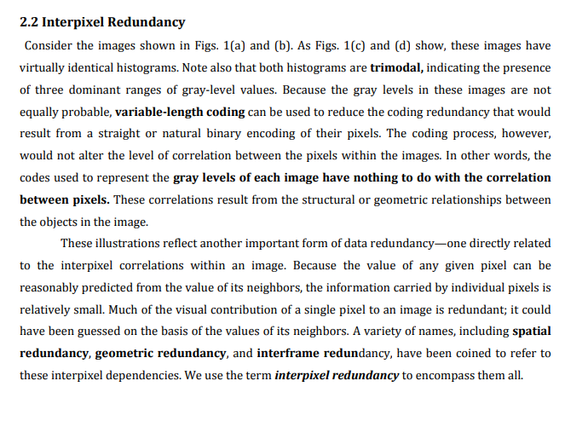

Slide 37
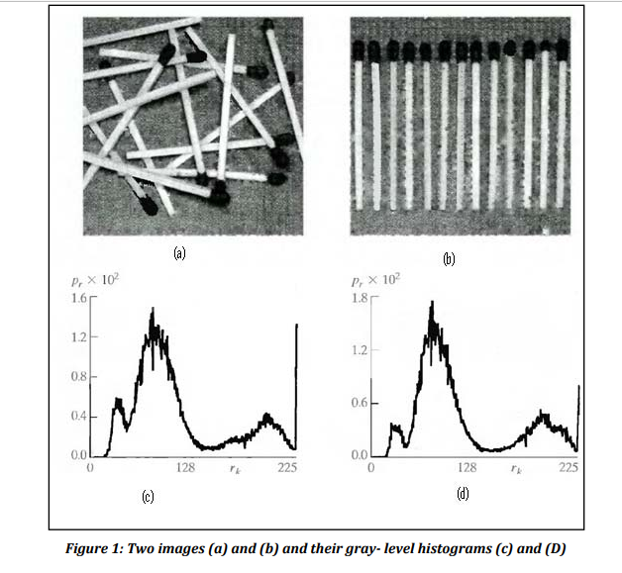

Slide 38
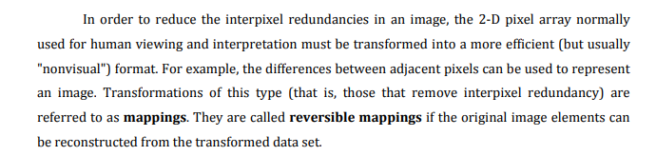

Slide 39
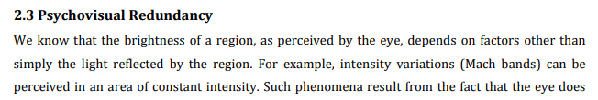
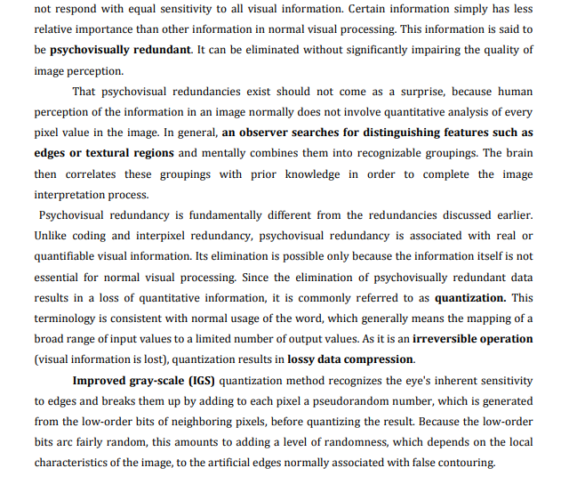

Slide 40
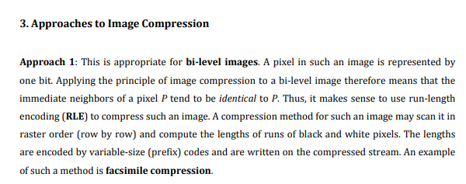

Slide 41
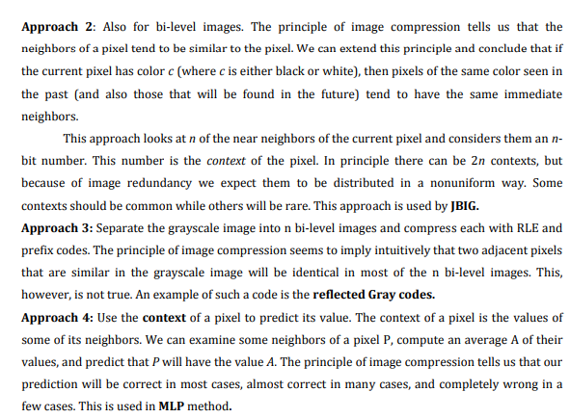

Slide 42
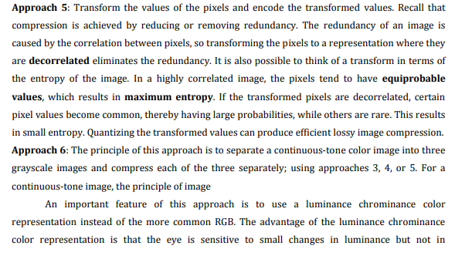

Slide 43
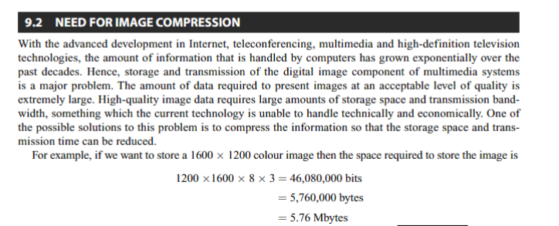

Slide 44
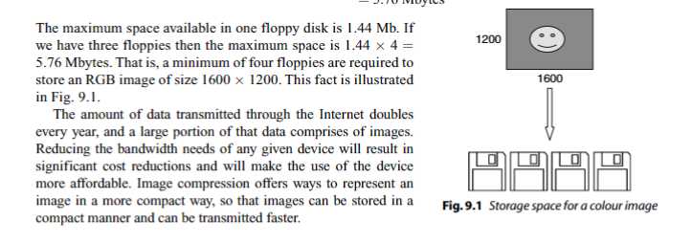

Slide 45
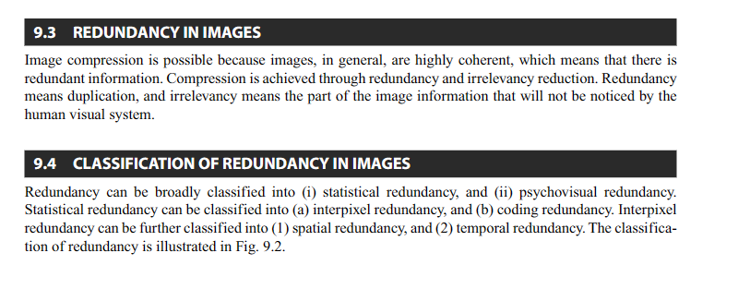

Slide 46
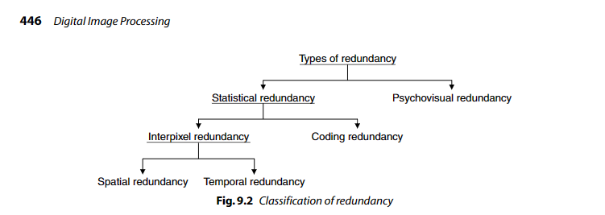

Slide 47
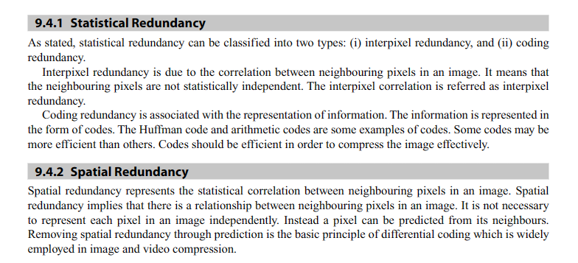

Slide 48
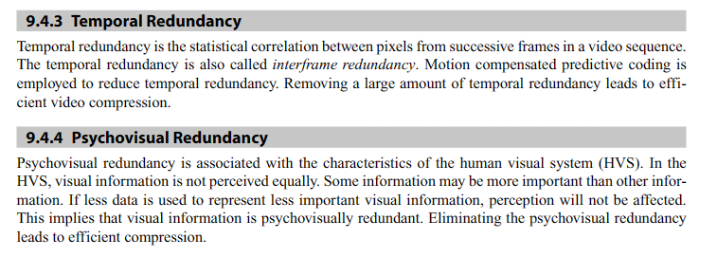

Slide 49
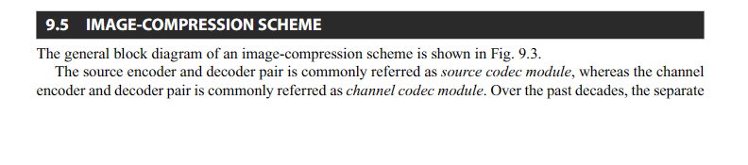
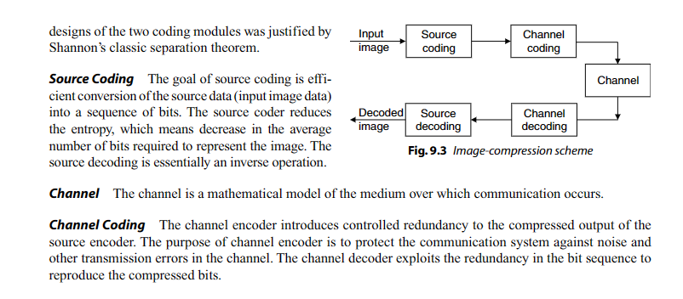

Slide 50
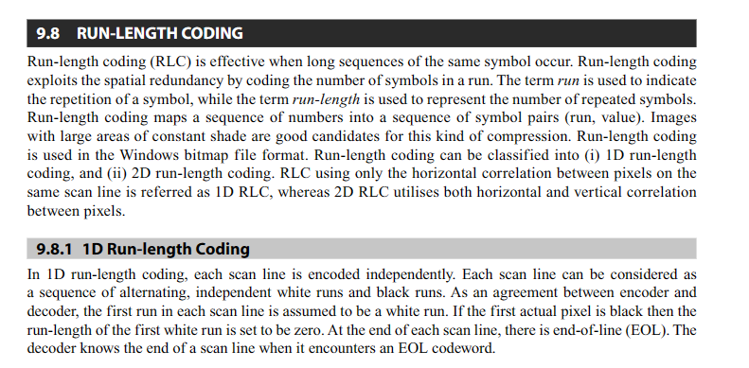
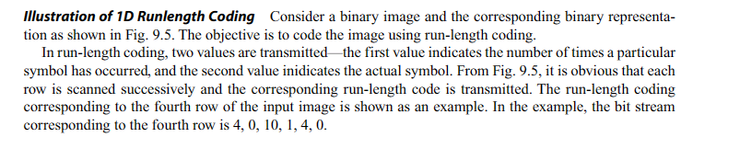

Slide 51
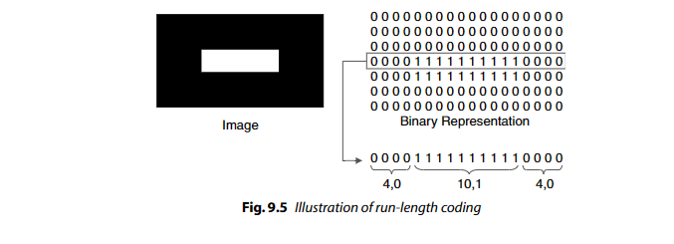
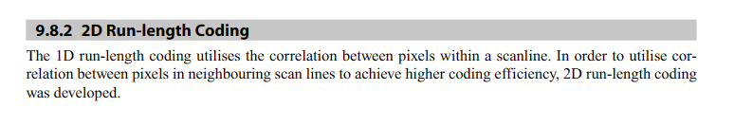

Slide 52
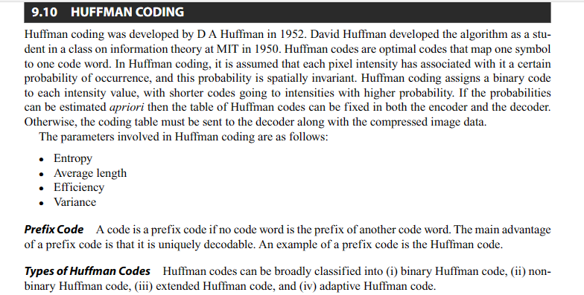

Slide 53
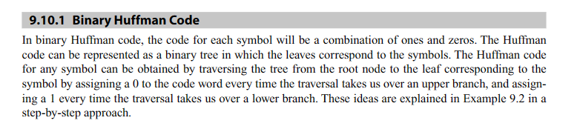
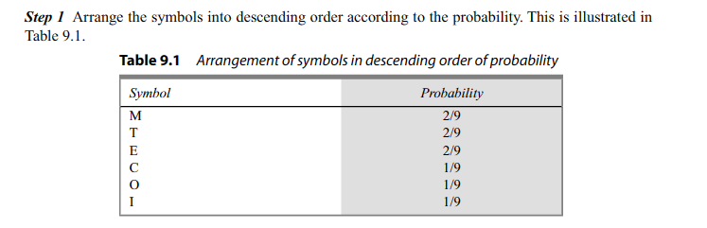

Slide 54


Slide 55


Slide 56



Slide 57


Slide 58


Slide 59


Slide 60



Slide 61


Slide 62



Slide 63



Slide 64


Slide 65


Slide 66


Slide 67


Slide 68



Slide 69


Slide 70


Slide 71



Slide 72



Slide 73


Slide 74


Slide 75


Slide 76


Slide 77


Slide 78



Slide 79


Slide 80


Slide 81



Slide 82



Slide 83


Slide 84


Slide 85


Slide 86


Slide 87


Slide 88


Slide 89



Slide 90


Slide 91


Slide 92


Slide 93


Slide 94


Slide 95


Slide 96


Slide 97


Slide 98


Slide 99


Slide 100


Slide 101


Slide 102


Slide 103


Slide 104


Slide 105
Lossy Compression
All real world measurements inherently contain a certain amount of noise.
If the changes made to these signals resemble a small amount of additional noise, no harm is done. Compression techniques that allow this type of degradation are called lossy.
Lossy techniques are much more effective at compression than lossless methods. The higher the compression ratio, the more noise added to the data.

Slide 106
Lossy Compression Techniques
Two most common and widely used technique for image and video compression are:-
JPEG Image Compression
MPEG Video Compression

Slide 107
JPEG Image Compression
JPEG is named after its origin, the Joint Photographers Experts Group.
Best example of transform compression is JPEG standard.
Transform compression is based on a simple premise: when the signal is passed through the Fourier (or other) transform, the resulting data values will no longer be equal in their information carrying roles.

Slide 108
JPEG Image Compression Method
JPEG compression starts by breaking the image into 8×8 pixel groups.
Each pixel is a single byte, a grayscale value between 0 and 255.
Each group is initially represented by 64 bytes. After transforming and removing data, each group is represented by, say, 2 to 20 bytes.

Slide 109
JPEG Image Un-compression Method
During un-compression, the inverse transform is taken of the 2 to 20 bytes to create an approximation of the original 8×8 group.
These approximated groups are then fitted together to form the uncompressed image.
Fourier transform is easy to use, but does not provide adequate compression so we use Discrete Cosine Transform (DCT).
Fourier transform uses sine and cosine waves to represent a signal, but the DCT only uses cosine waves.

Slide 110


Slide 111


Slide 112

Effects Of Compression Ratio

